Slide 1

Digital Collections & Exhibitions with Omeka
[keyboard cat] by Cassandra Leigh Gotto on Flickr CC BY-NC 2.0

Slide 2
Why & how are
scholars creating digital collections & exhibitions?
Notes:
Chelcie: Does your library create exhibits, physical or digital? Have you been involved in creating exhibits? What was your role?

Slide 3
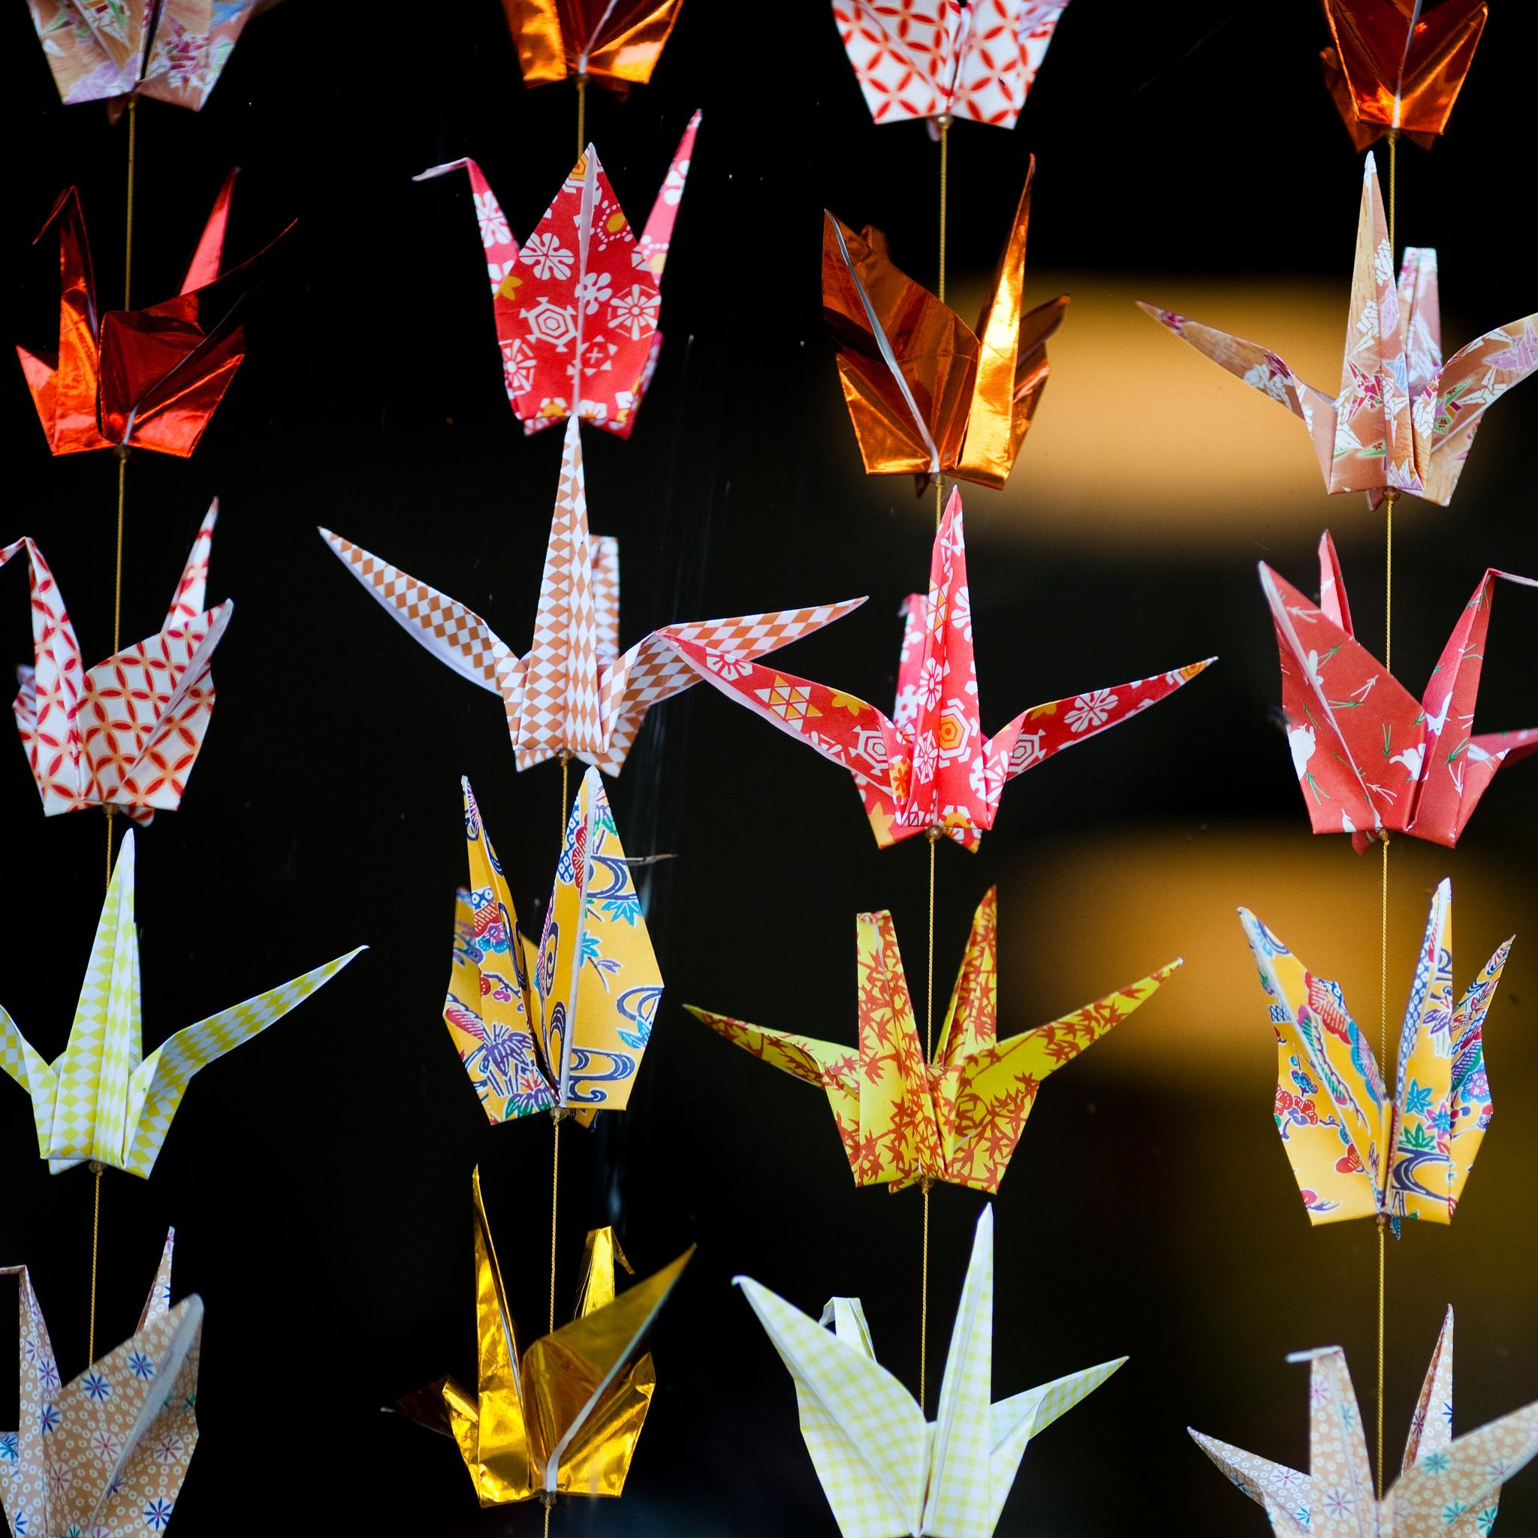
Omeka Genres
Birdy by Thomas Hawke on Flickr CC BY-NC 2.0

Slide 4
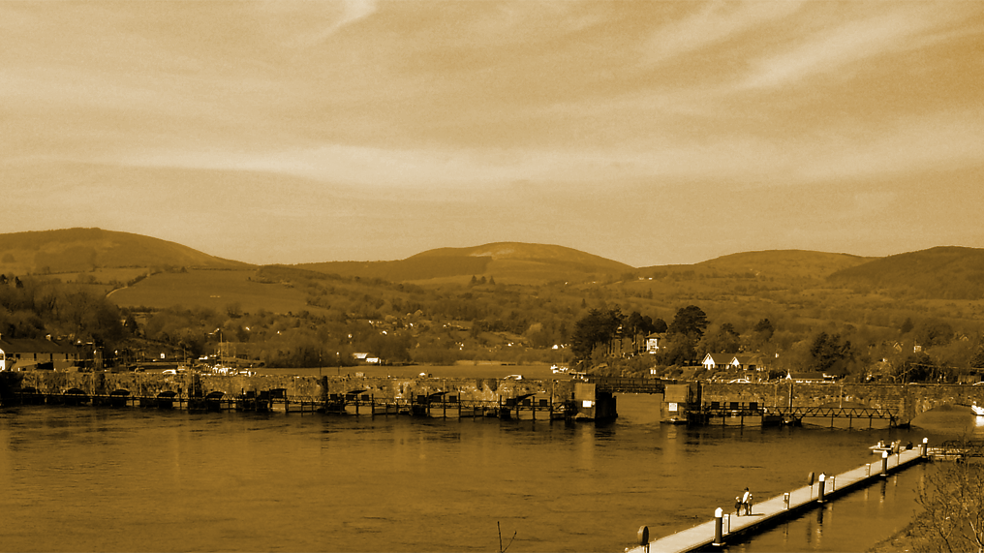
Thematic digital collections
connollymusiccollection.bc.edu

Slide 5
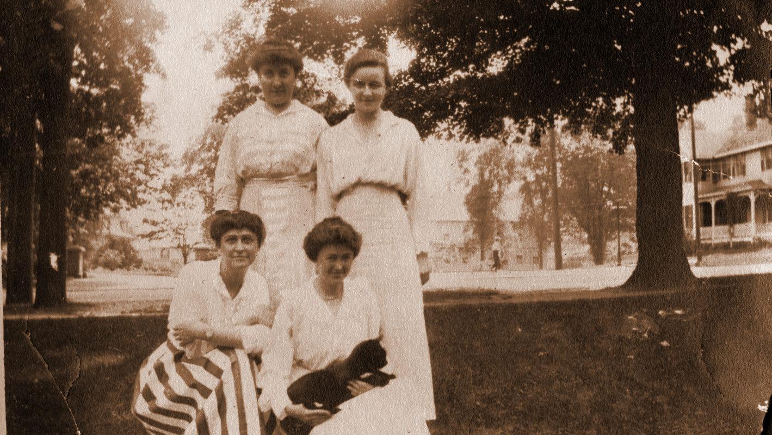
Digital exhibitions
dp.la/exhibitions/exhibits/show/history-us-public-libraries

Slide 6
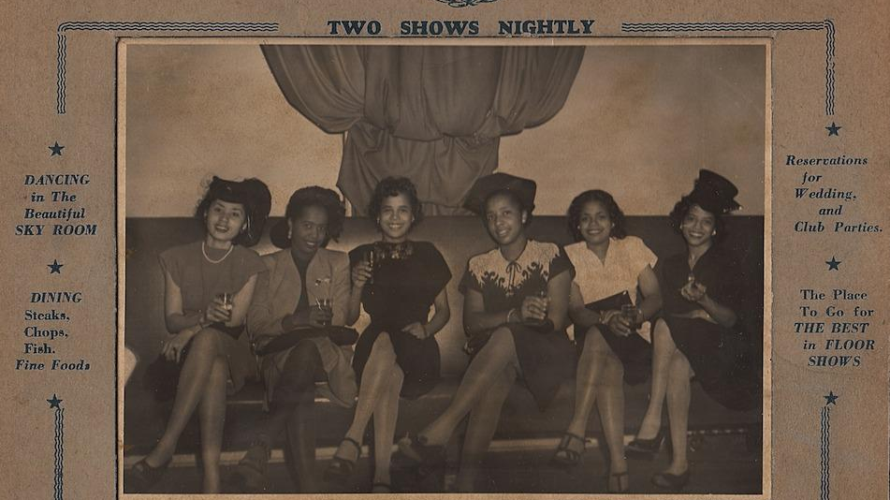
Course-based digital projects
historyharvest.unl.edu

Slide 7
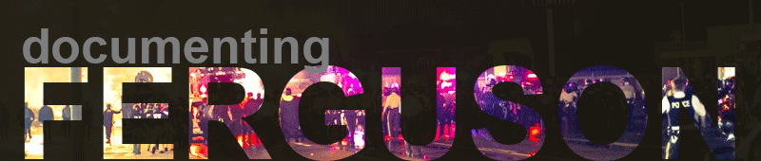
Community digital history projects
digital.wustl.edu/ferguson

Slide 8
Omeka flavors
Omeka.net
Hosted
Limited plugins & themes, based on plan
File size limits
Free trial
Omeka.org
Self-hosted (requires a server)
Unlimited plugins & themes
Size limits depend on server
Free...ish
OmekaS
In beta
Requires a server
Multi-site capabilities

Slide 9
The Omeka Ecosystem
Notes:
Themes
CurateScape
Plugins

Slide 10
Exercise 1: Critique

Slide 11
Information architecture of Omeka
Items
Collections
Omeka site
Exhibits

Slide 12
Metadata
What are you describing?
Boston landmark ?
Photo of the Boston landmark ?
Digital file of the photo of the Boston landmark ?

Slide 13
Metadata
To describe an item, ask yourself:
What is the item of ?
What is the item about ?

Slide 14
Metadata
2 kinds of metadata standards we’re focusing on:
Metadata fields → Dublin Core Elements
Data format within metadata fields → Controlled vocabularies
Be consistent across records! Use standardized terms (aka controlled vocabularies) when possible.

Slide 15
Metadata
Dublin Core Terms
Dublin Core Elements
DCMI Type Vocabulary
DC fields are repeatable.
DC fields are extensible.

Slide 16
Metadata
It’s a good idea to create a data dictionary for your project, that is, how you will structure the data that you enter in each metadata field.
What fields? Which are required? Which recommended?
Title. Title case or sentence case? Supplied information in brackets?
Subject. Is there a particular controlled vocabulary that makes sense for the items in your Omeka project? LCSH, TGM, etc.

Slide 17
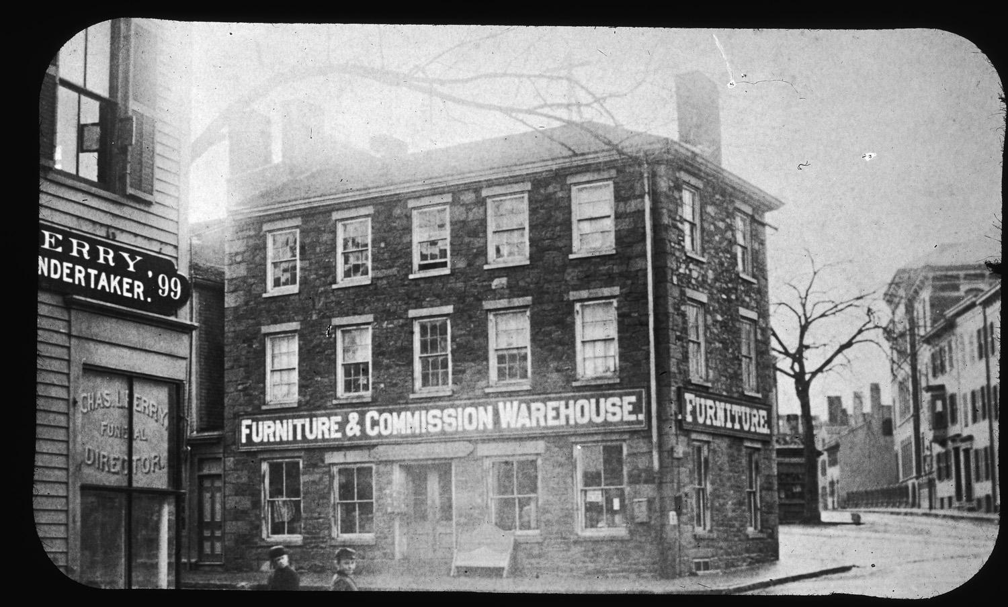
Exercise 2: Description & Arrangement

Slide 18
What kinds of projects might not be good candidates for Omeka?

Slide 19
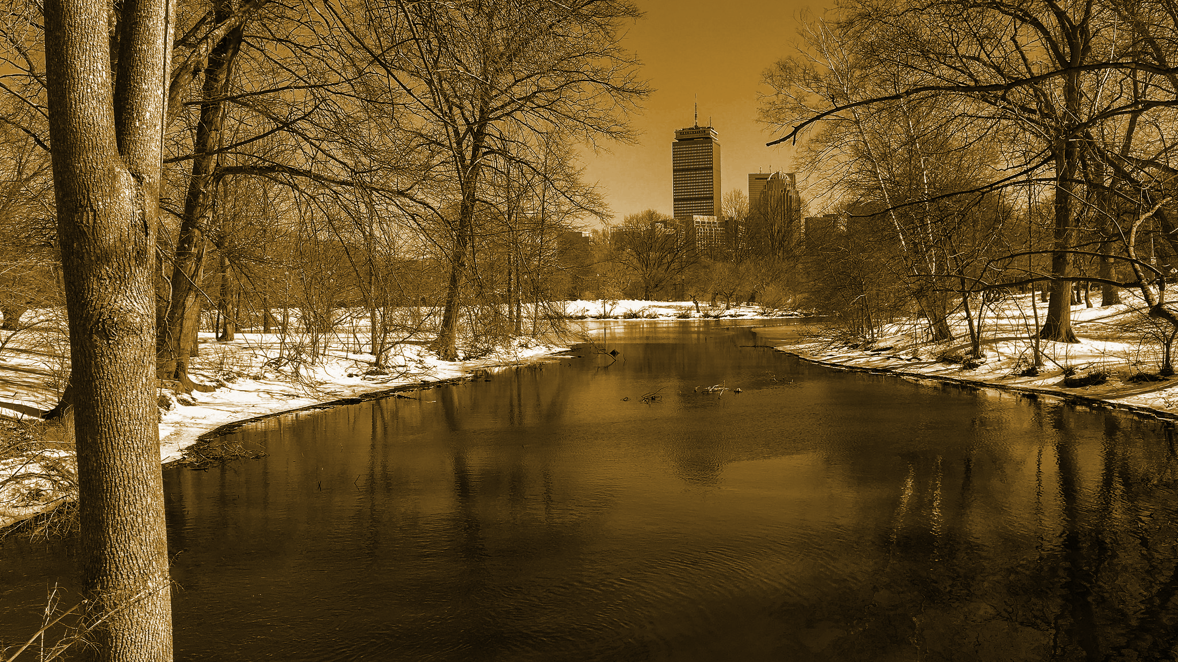
Omeka.net Demo

Slide 20
Exercise 3:
Create in Omeka
Transfer item descriptions from cards to shared metadata spreadsheet in Google Drive.
Add a new item.
Add a new collection.
Make an exhibit.

Slide 21
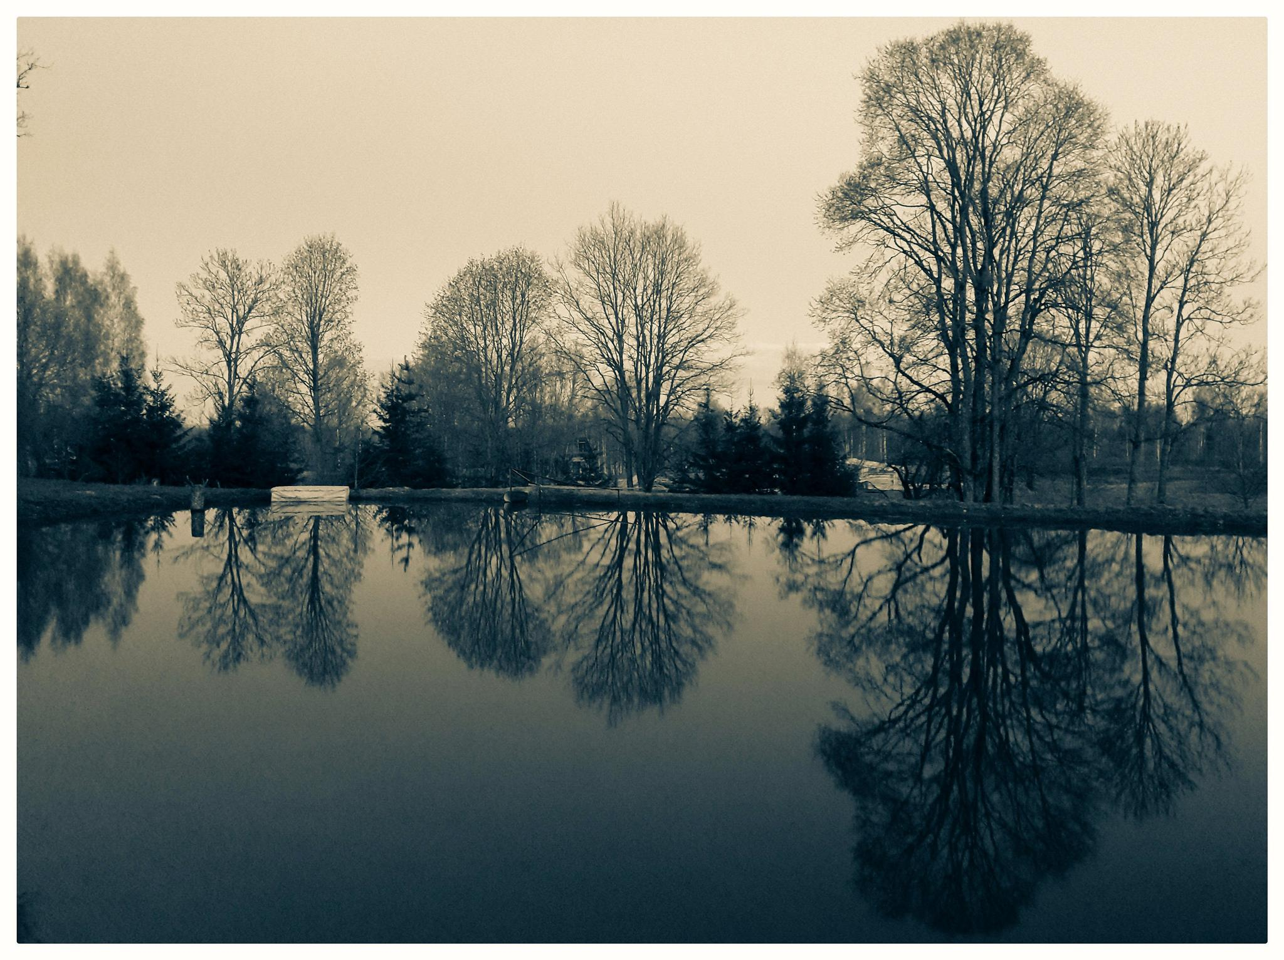
Closing Reflection
Notes:
Discuss in pairs: your expertise, needed skills & expertise for Omeka projects, potential collaborators.

Slide 22
Credits
Special thanks to all the people who made and released these awesome resources for free.
Presentation template by SlidesCarnival
Photographs by Unsplash
Learn more about slidedocs at duarte.com/slidedocs

